Slide 1
Small Satellite Attitude Control System Test Bed
Bryan Sonneveldt
Mentor: Dr. Iman Alizadeh
School of Earth and Space Exploration and Ira A. Fulton Schools of Engineering
at Arizona State University

Slide 2
Outline
Background and Purpose
  - Why satellite test beds?
Our System
  - The whole test bed
Spherical Air Bearing
  - How we saved $3,000
Simulation of System
- Testing without the test bed

Slide 3
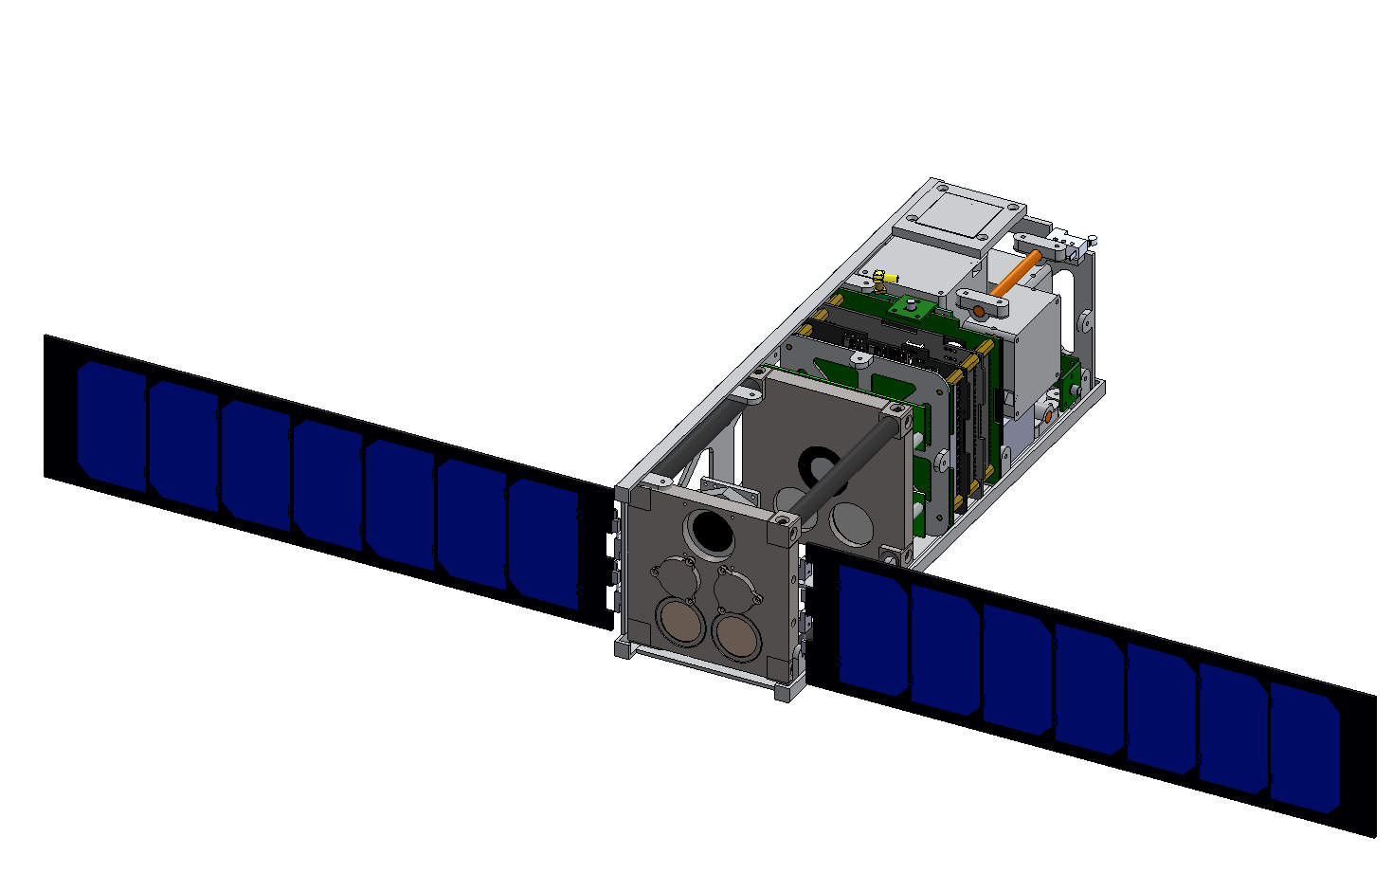
Reason for Satellite Attitude Control Test Beds
Simulating a space environment
  Microgravity, reduced friction, etc.
Verifying Hardware
Testing New Methods
Key Component
  Spherical air bearing
Former SDSL CubeSat project – SDS1

Slide 4
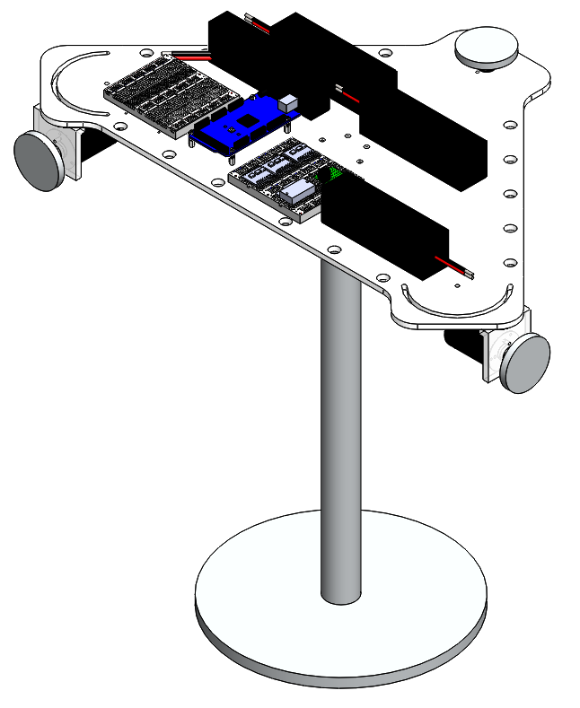
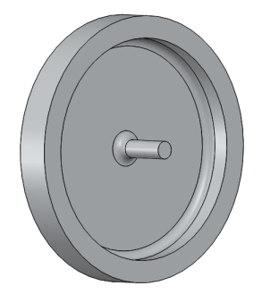
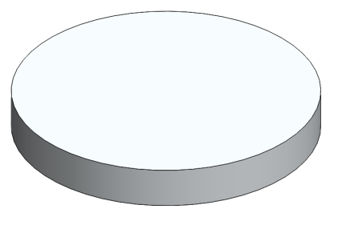
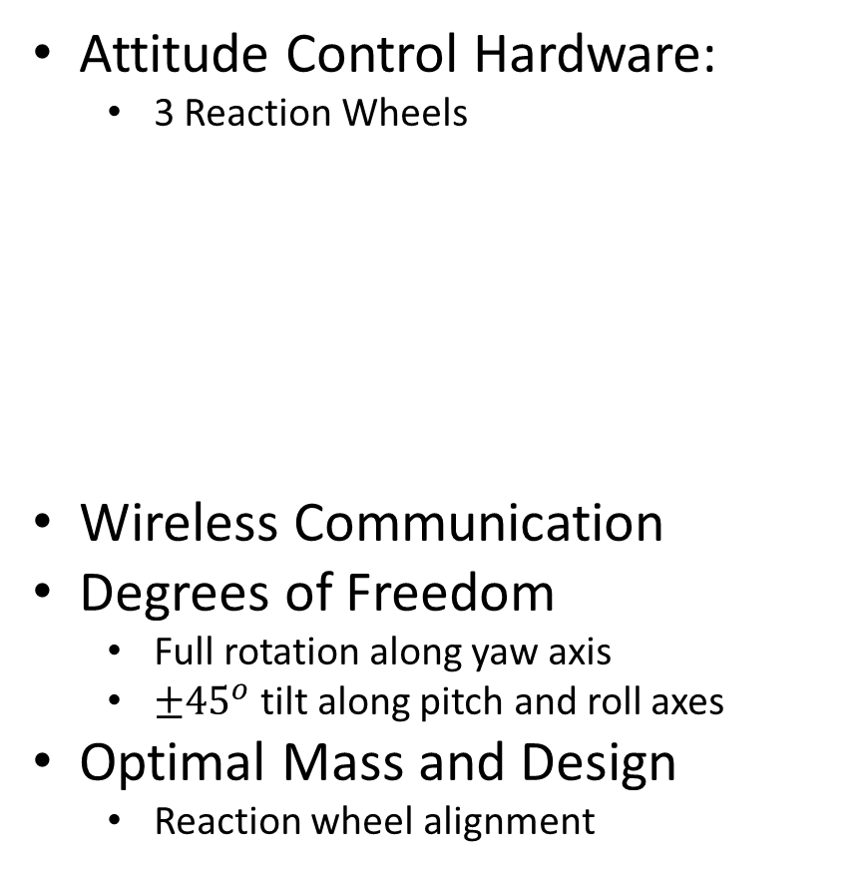
Complete Test Bed
Attitude Control Hardware:
  3 Reaction Wheels
Wireless Communication
Degrees of Freedom
  Full rotation along yaw axis
  $±{45}^{o}$ tilt along pitch and roll axes
Optimal Mass and Design
  Reaction wheel alignment
component plate
Reaction Wheel View 1
Reaction Wheel View 2
reaction wheels
Attitude Control System Test Bed

Slide 5
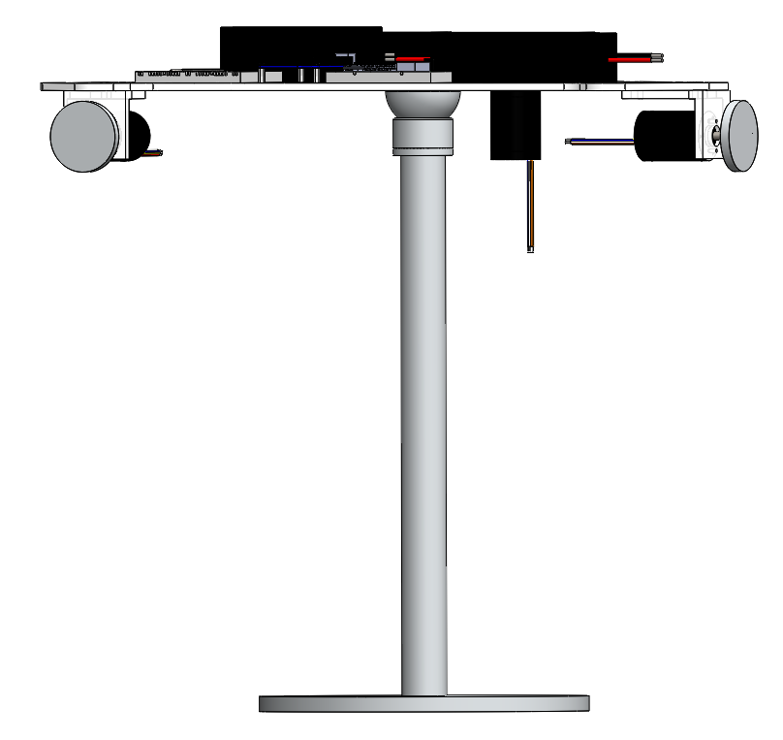
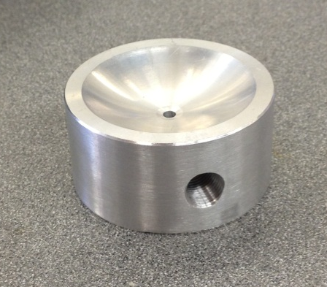
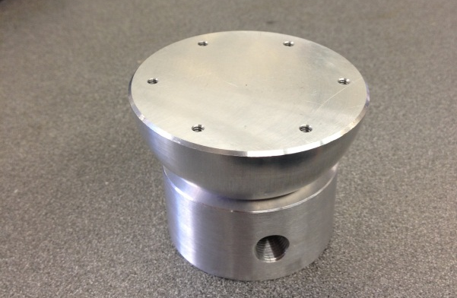
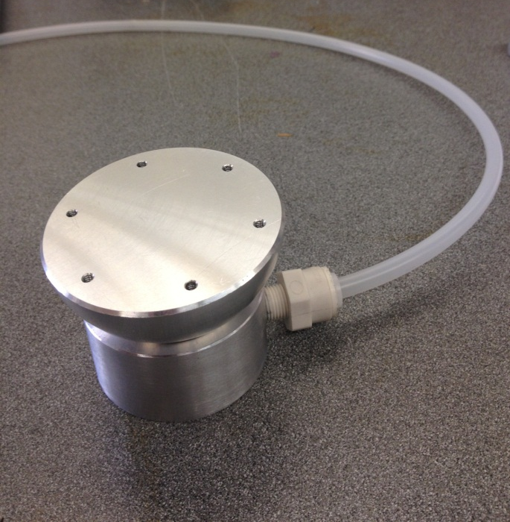
Spherical Air Bearing
Machined in-house
spherical air bearing
Bearing Container
Spherical Air Bearing and Container
Test Bed Assembly Front View
air supply
air inlet
Single air inlet
Pressure regulator controls air flow
Machining air bearing from scrap aluminum saved about $3,000
thin film of air between bearing and container
Spherical Air Bearing With Air Supply

Slide 6

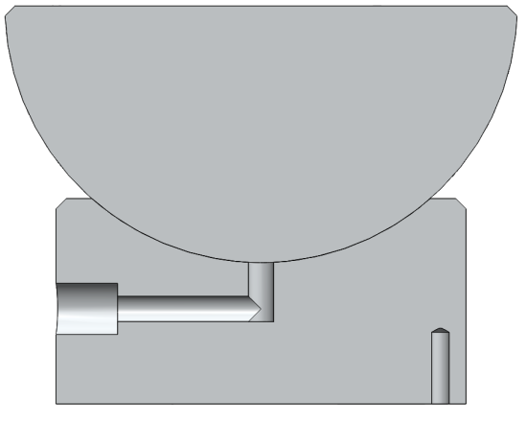
Spherical Air Bearing
Videos
https://www.youtube.com/watch?v=nf_p_WacpNY
https://www.youtube.com/watch?v=WNrec5pNju0&feature=youtu.be
45º
Bearing Assembly – Degrees of Freedom
Bearing Assembly – Section View

Slide 7
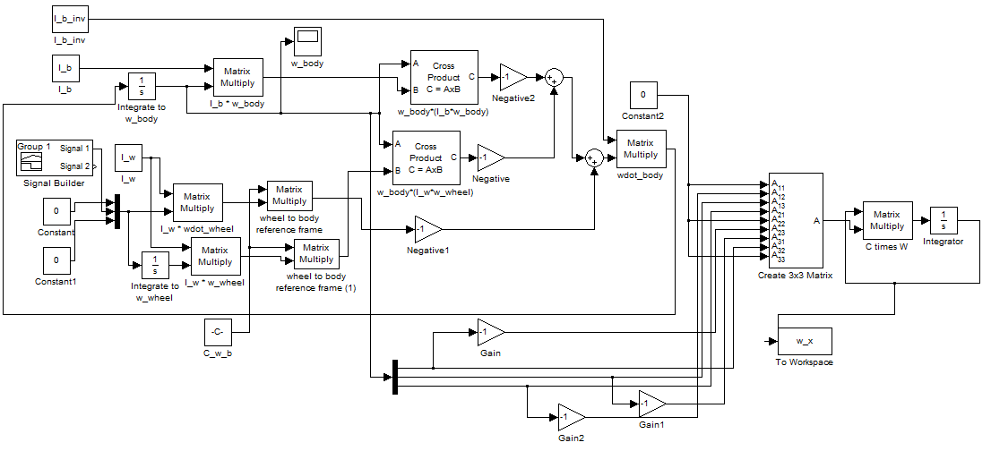
Simulation
Why a Simulation?
Assumptions made..
https://www.youtube.com/watch?v=4HBlPNE2bf8&feature=youtu.be
https://www.youtube.com/watch?v=eKiAZq_Ch4A

Slide 8
Conclusion/Next steps
Verify performance of spherical air bearing
Test and Refine Control Algorithms
    Using the simulation and physical test bed
Adjust reaction wheels to align with principal axes of inertia
Start testing small satellite attitude control systems

Slide 9
Thank You
Questions or Comments?
Name: Bryan Sonneveldt
Email: bsonneve@asu.edu
Attitude Control System Test Bed

